Slide 1
GroupPowerSave
Final Presentation
Advanced Mobile Computing S19 - Team 7

Slide 2
Contents
Overview
Project Design
Client
Server
Matching Algorithm Flow
Group Candidate Clustering
Group Matching
Evaluation
Battery Usage
Matching Algorithm
Demo
Conclusions and Further work

Slide 3
Overview

Slide 4
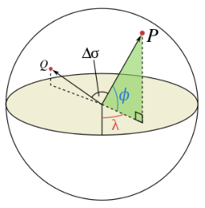
GPS-data Sharing
Calculate geometric-distance between users
(long, lat) → “Haversine” distance
User Clustering
GPS-data Sharing

Slide 5

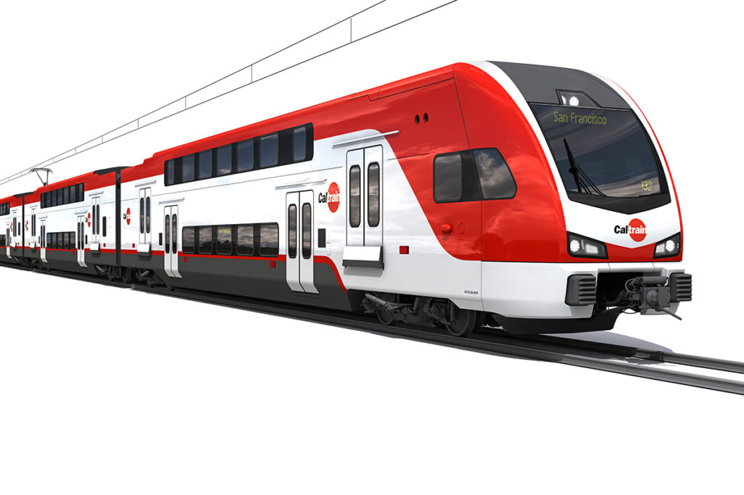
GPS-data Sharing
Transportation System
Provide GPS with group to reduce power consumption

Slide 6
Project Design

Slide 7
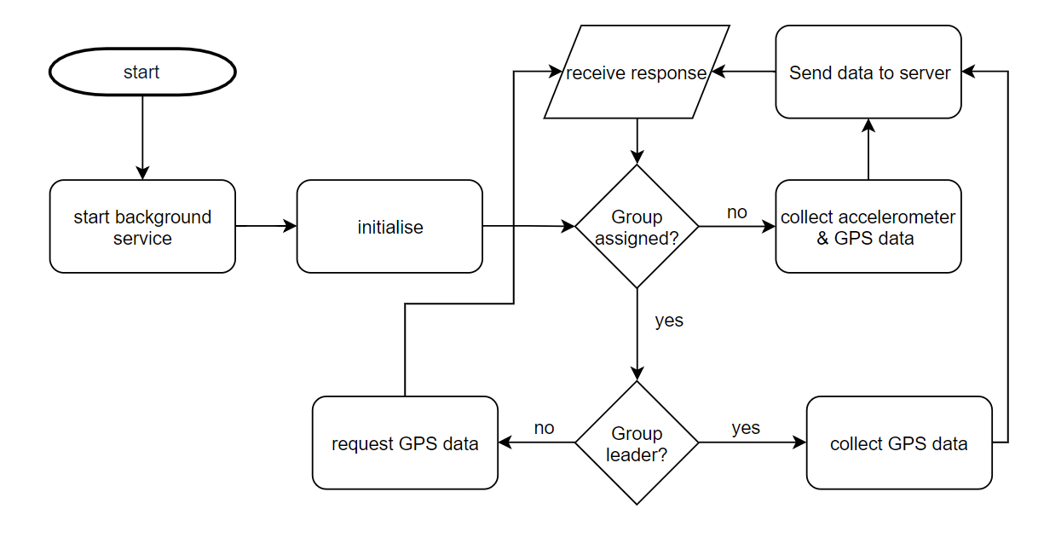
Clients
Act as a leader/group member
Peak Calculation for group matching
To reduce communication cost

Slide 8
Server
Group Match
User Data
HTTP
Server
User Validation
Role Update
Position Update
Not Assigned User
Group Leader
Group Member

Slide 9
Matching Algorithm Flow
1.
GPS-data
Initial Clustering
GPS-data
&
Accelerometer data
2.
Acc-data
Group Matching
3.
Group Consistency Check
GPS-data
[ Server ]
[ Client ]

Slide 10
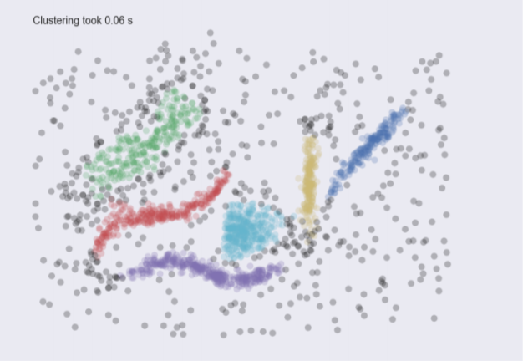
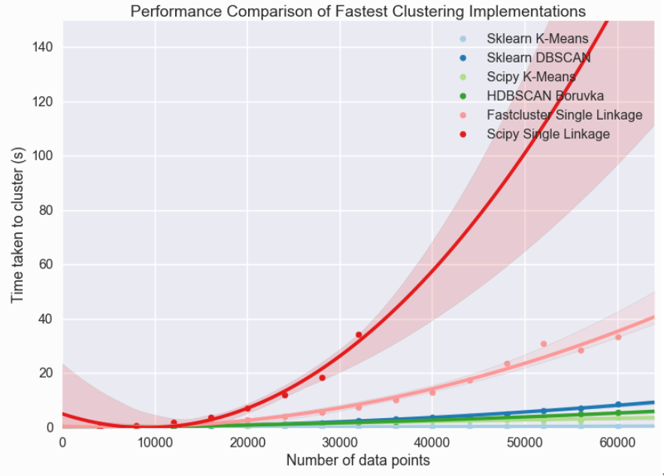
Initial Clustering
HDBSCAN(Hierarchical Density Based Clustering)
Robust and Fast Clustering Algorithm
min_cluster_size : minimum members of group
[ HDBSCAN result ]
[ Comparison of Speed ]

Slide 11
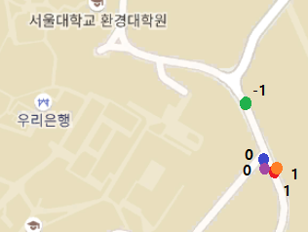
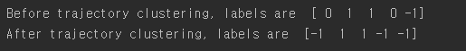
Initial Clustering
Trajectory Distance Clustering
Calculate distance between each user’s trajectory using N-steps gps-data .
Do clustering with the distances
[ 4-users gps data test ]

Slide 12
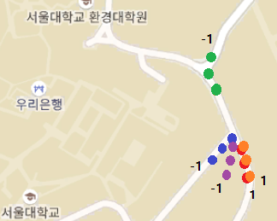
Initial Clustering
Trajectory Distance Clustering
Calculate distance between each user’s trajectory using N-steps gps-data .
Do clustering with the distances
[ 4-users gps data test ]

Slide 13
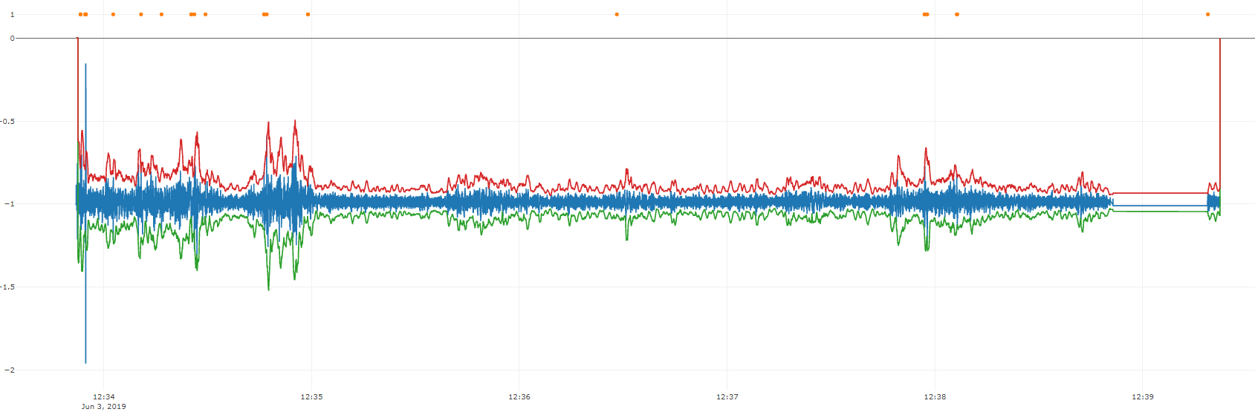
Group Matching
Smoothed Z Score Algorithm
Adaptively compute the threshold for a peak detection

Slide 14
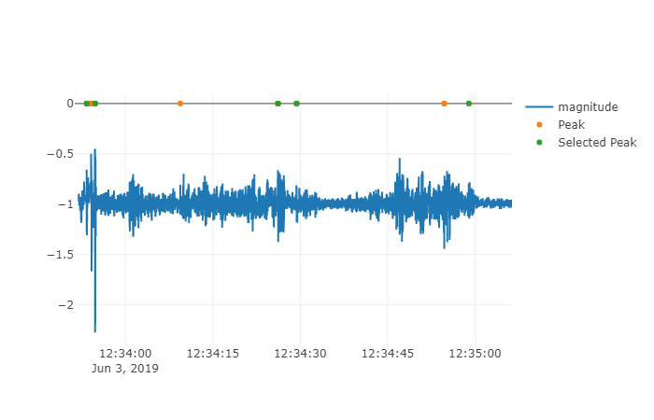
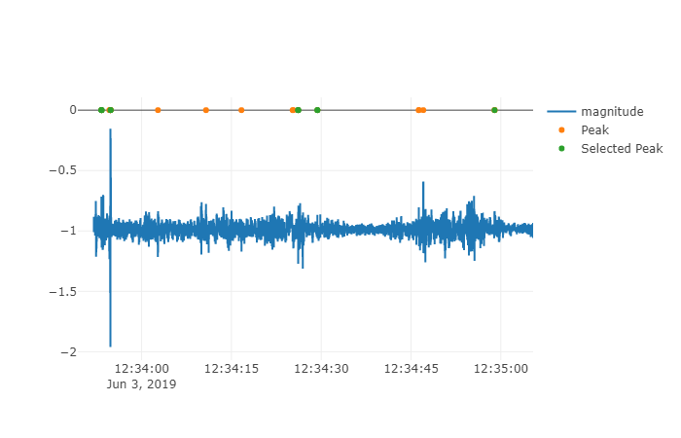
Group Matching
Peak Similarity
1 Minute Window
More than 3 similar peaks (< 0.1s)

Slide 15
Evaluation

Slide 16
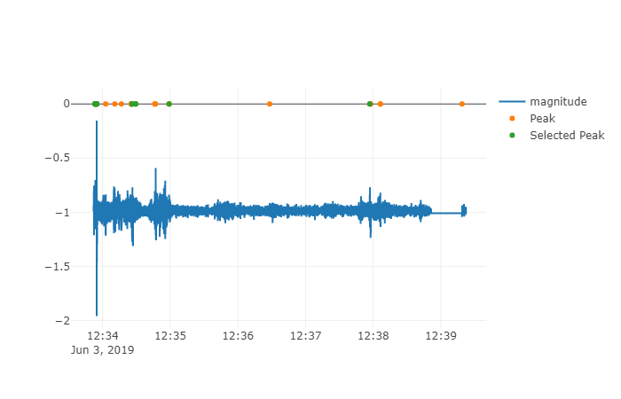
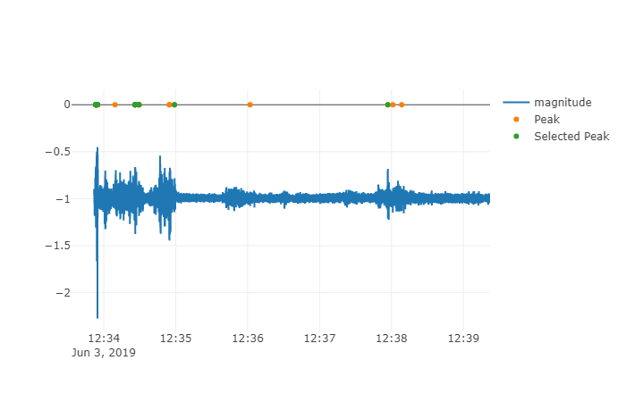
Matching Algorithm
6512 Bus Data
3 matches from 7 minutes of ride
6512 Bus IPhone
6512 Bus IPad

Slide 17
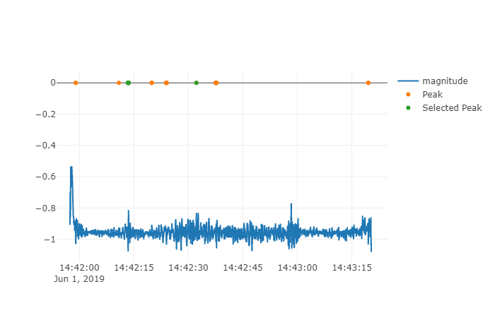
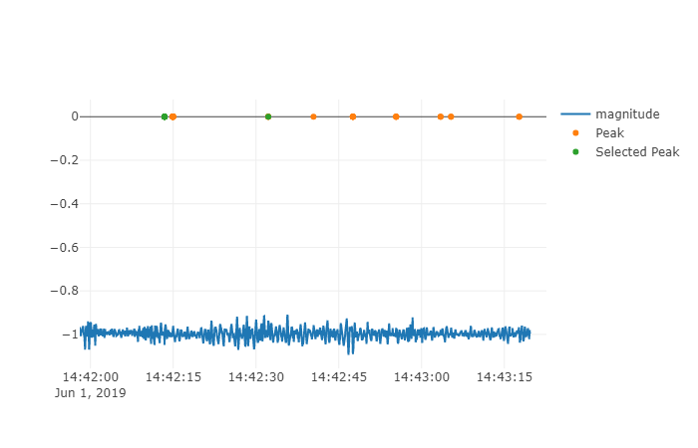
Matching Algorithm
Bongcheon - SNU Subway Data
successfully matched during 1~ minute of ride
Bongcheon - SNU Subway IPhone
Bongcheon - SNU Subway IPad

Slide 18
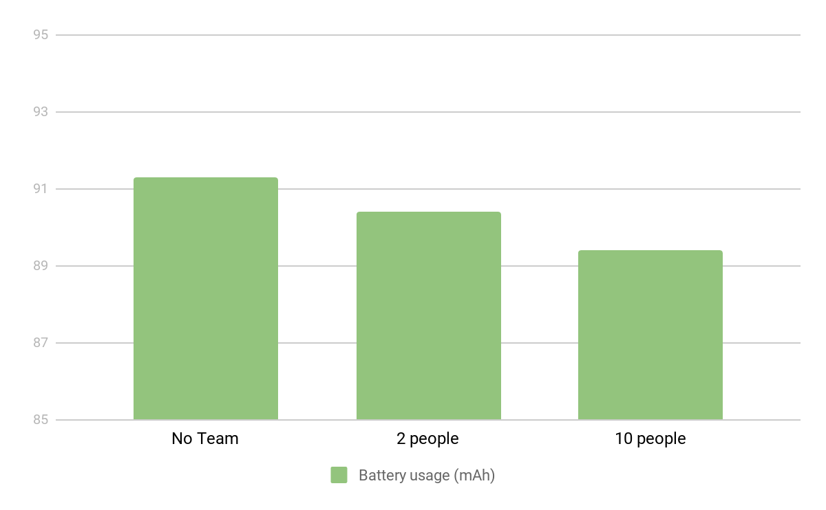
Battery Usage
1.9 mAh

Slide 19
Mock Client Demo

Slide 20
Conclusions & Further work

Slide 21
Conclusions
Good Points
Greatly reduces battery consumption
Completely runs in the background
Weak Points
Heuristic based matching
Requires illegal Mock permission
Overhead for non registered members

Slide 22
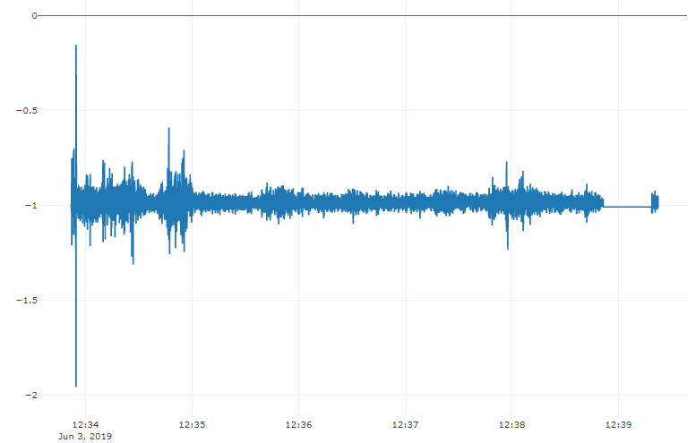
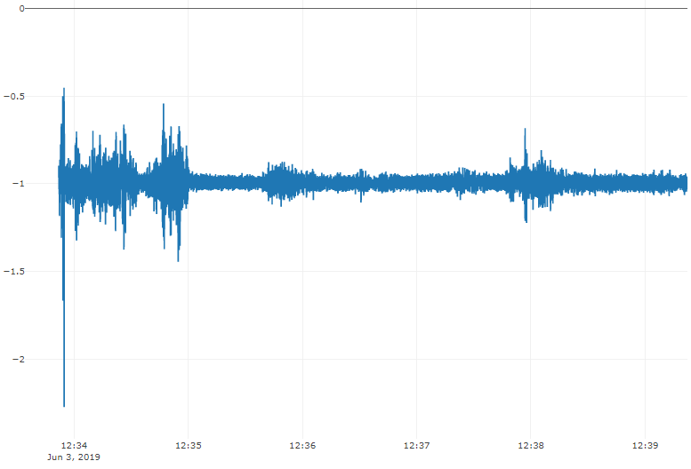
Further Work
Possibility to use a machine learning based algorithm
6512 Bus IPhone
6512 Bus IPad

Slide 23
Further Work
Implement as library, not as app
Scalability for matching algorithm
More testing with more users
Write a paper and apply to MobiSys
Use accelerometer data instead of GPS for initial matching group confirmation

Slide 24
Thank you for your attention

